Slide 1
Student Career Finder
Team Kryptonite

Slide 2

Andrew Krna, Project Owner
Jamie Andrews, Scrum Master
Steven Madrigal, Development Team
Edy Rosario, Development Team

Slide 3
Student Career Finder
Live Project Site: http://lamp.cse.fau.edu/~akrna/pk/login.html

Slide 4
Purpose
The Student Career Finder aims to enhance the internship reporter of the Owl Career Link (OCL). We eased the process by allowing students to report their internship without completing the lengthy account registration process, if they choose. We also allow students to report a job as well as an internship.

Slide 5
Motivation
In order for students to report an internship on the OCL they needed to complete a lengthy account registration process. We simplified that process by allowing students to submit their internships directly to their advisor without completing their student profile.

Slide 6
Functionalities
Register and Login to an account:
Student Account
Advisor Account
Students:
Complete/Edit profile
Submit an internship or job
View/Edit a submitted internship or job
Advisors:
Edit profile
Search and view student profiles
Edit submitted jobs or internships

Slide 7
Target Audience
This product is aimed towards universities who require their students to report their internships and jobs to their advisors.

Slide 8
System Implementation Infrastructure
Languages:
HTML
CSS
PHP
Javascript
MySQL

Slide 9
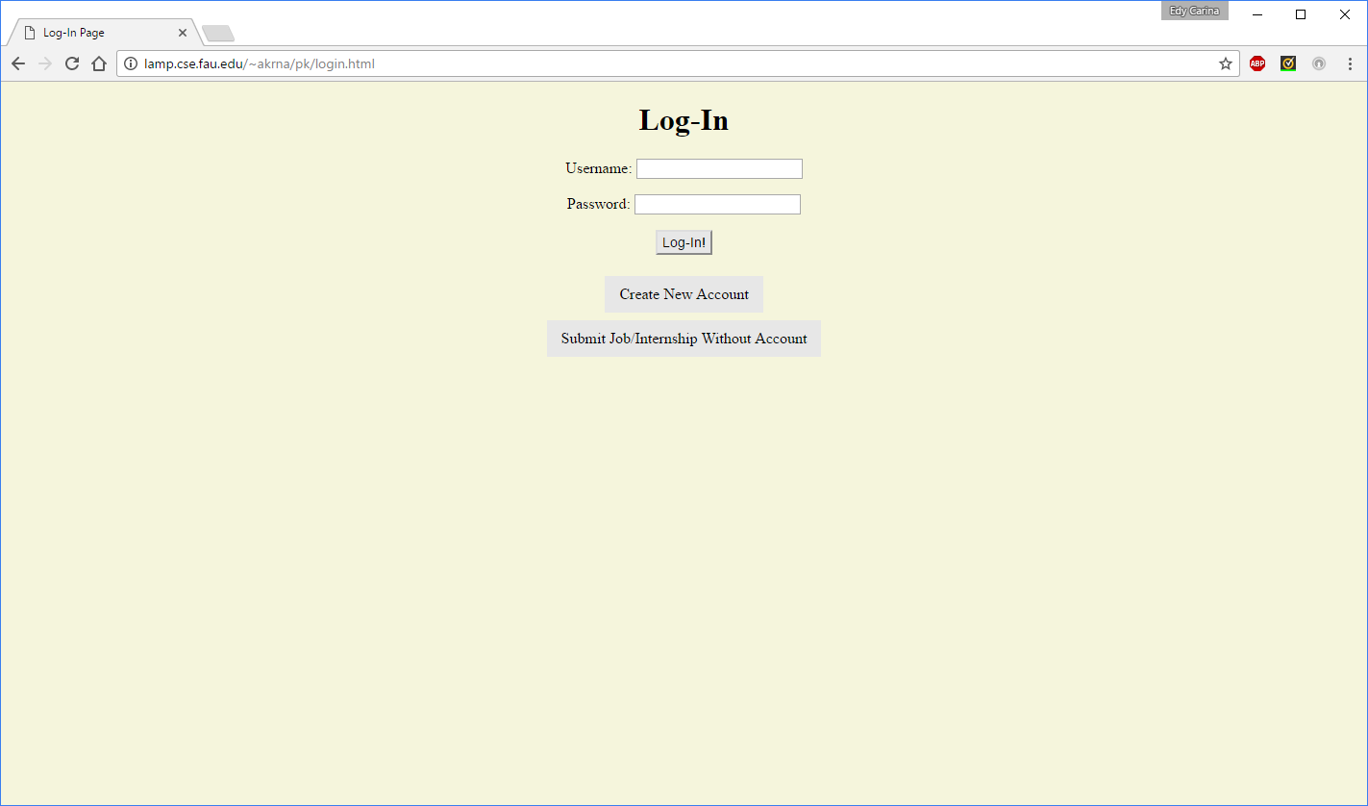

Slide 10
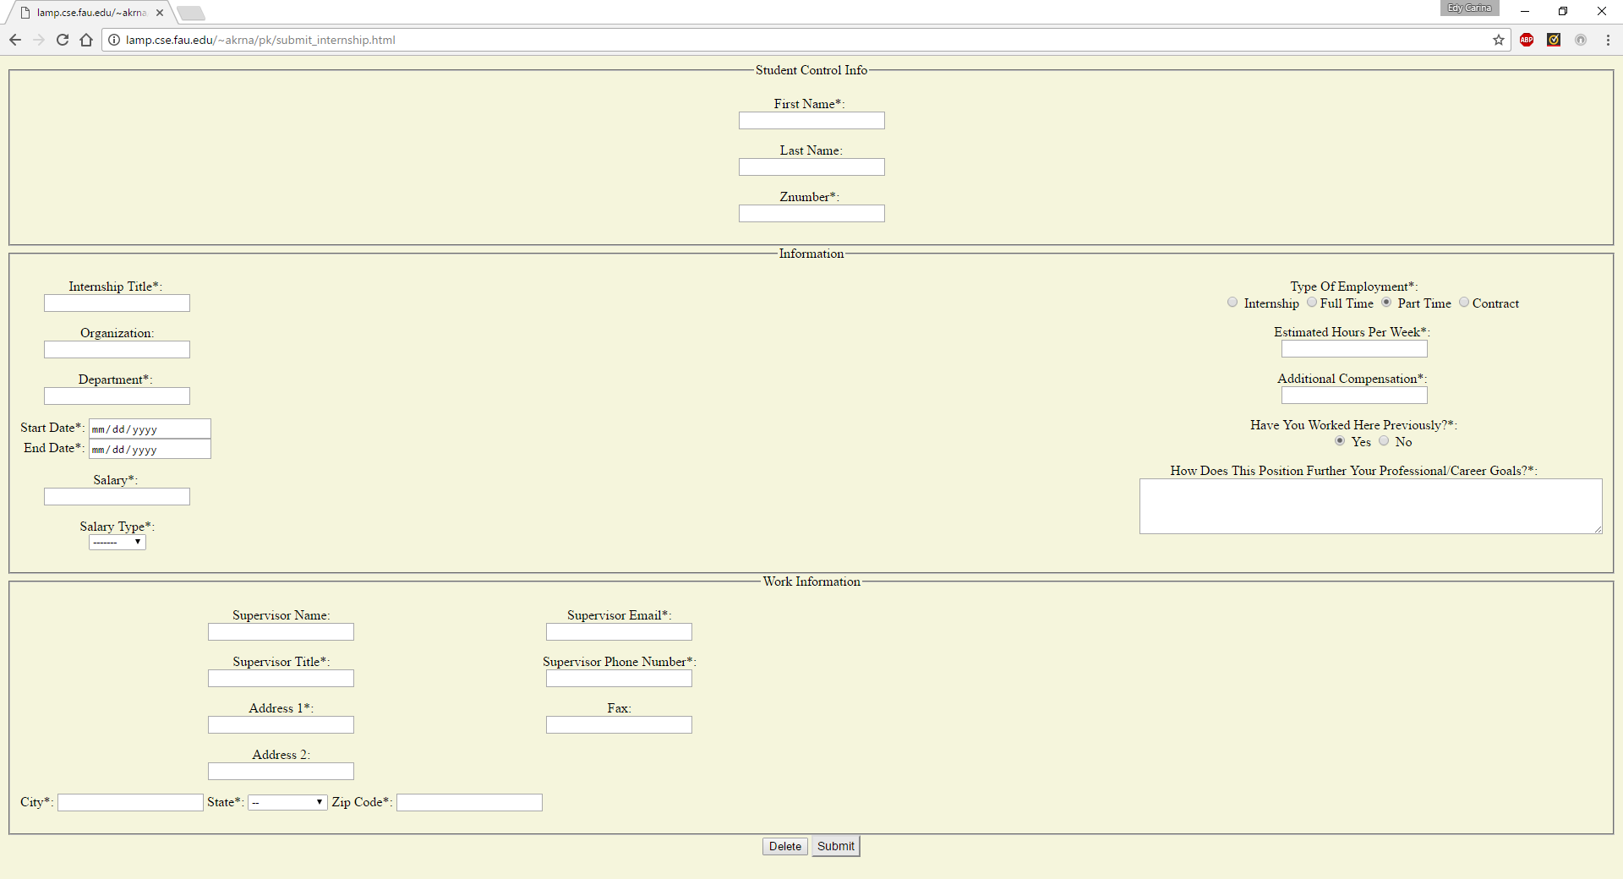

Slide 11
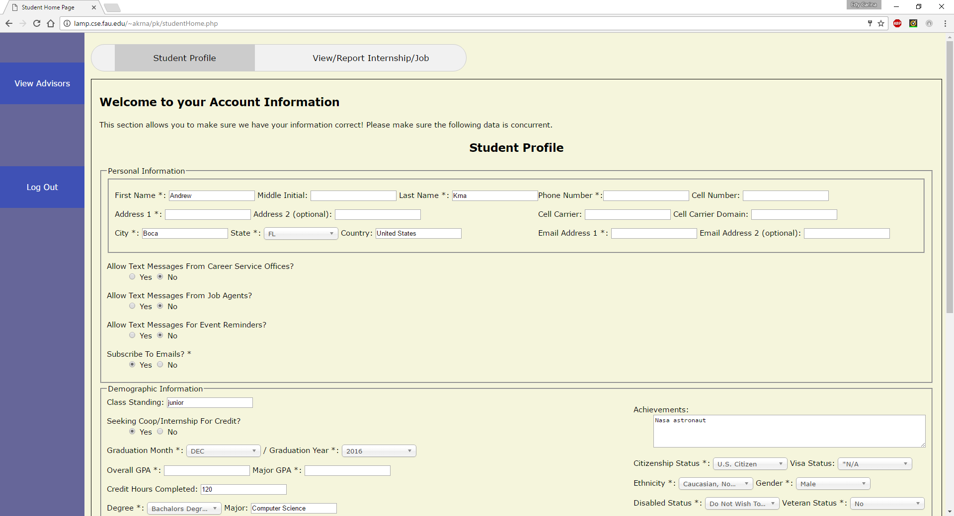

Slide 12
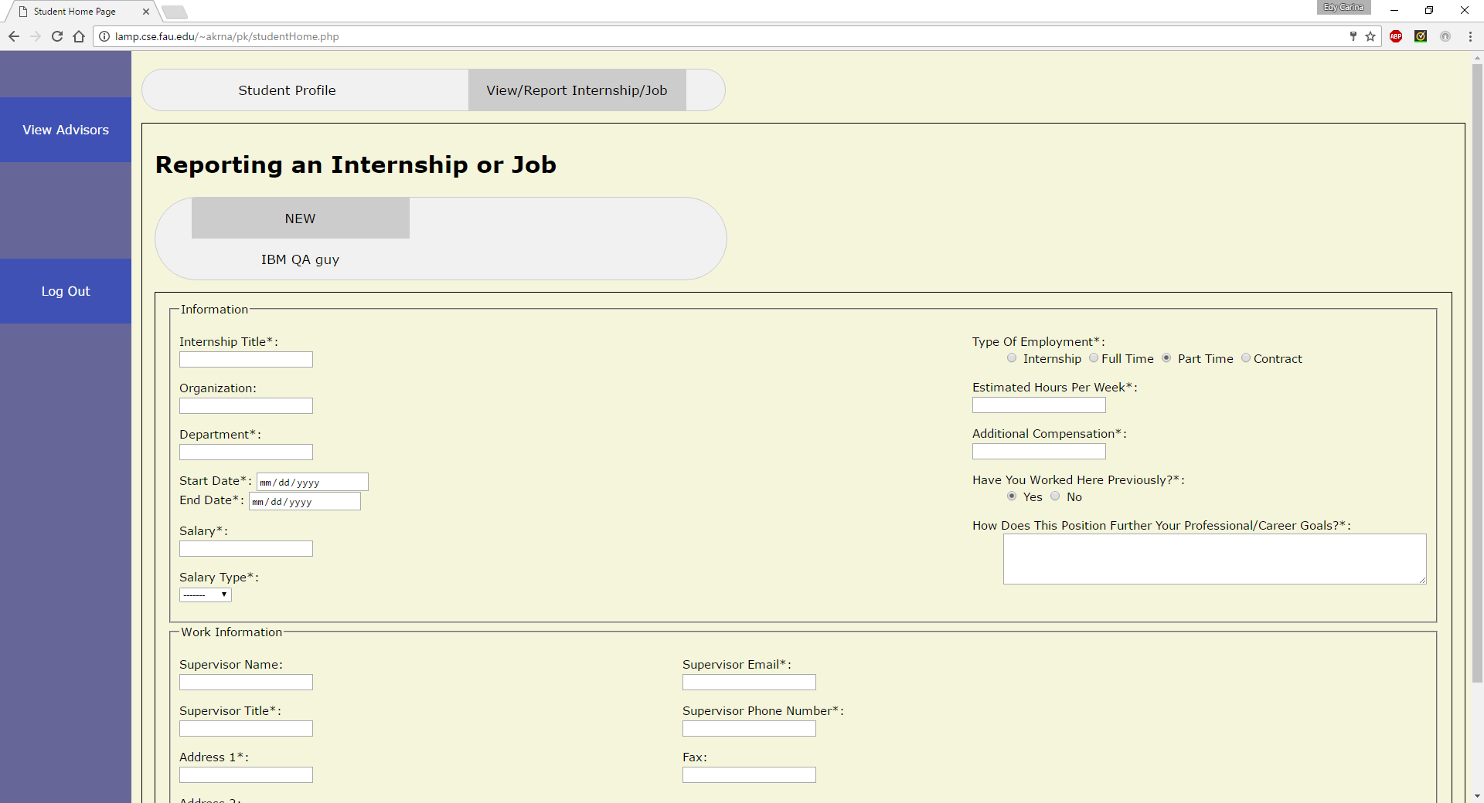

Slide 13
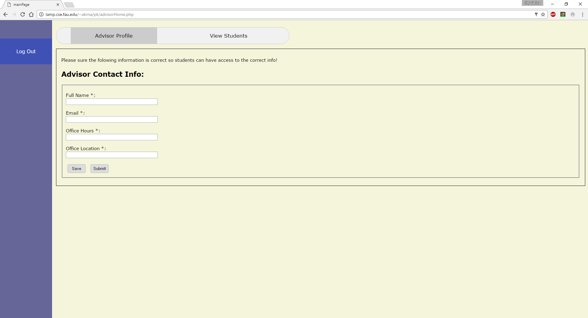

Slide 14
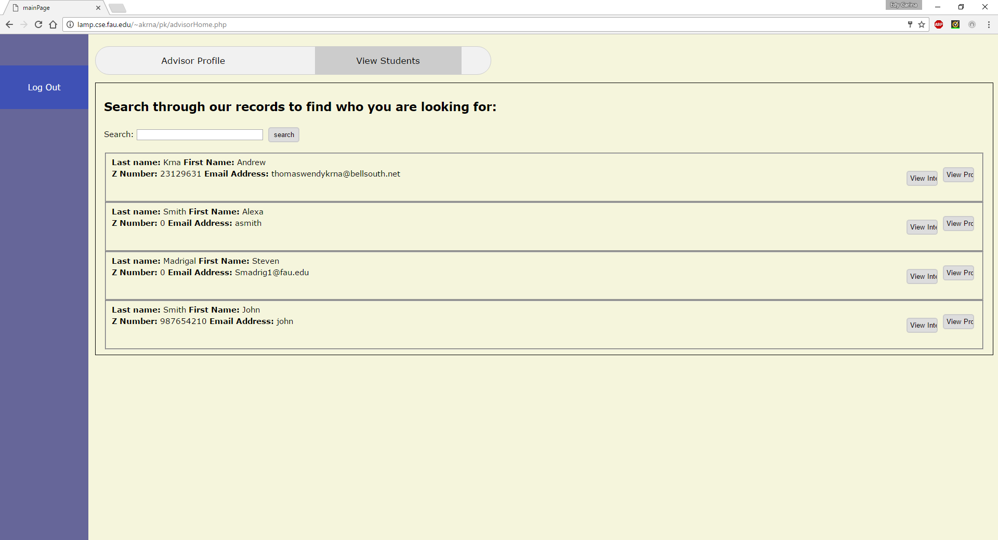

Slide 15
Features We Finished
Log In and Create Account
Student
Homepage
Create/Edit Account
Report Internship/Job
View reported internships/jobs
Advisor
Homepage
Create/Edit Account
View Students
Edit Student Account

Slide 16
Features We Would Like to Finish
Employer
Create Account
Post Jobs/Internships
View Students
Student
View posted jobs/internships
Apply for posted jobs/internships

